Slide 1
The Battle of Neighborhoods: Exploring
Montreal Neighborhoods to find the best
location for Korean restaurant.
Olga McIngvale May 9th, 2021

Slide 2





This project aims at exploring and segmenting the city of Montreal to give the recommendations to potential investors which were looking for the best place to open the Korean restaurant.

Slide 3
Data
Wikipedia data “List of postal codes of Canada: H” for the Metropolitan Montreal (https://en.wikipedia.org/wiki/List_of_postal_codes_of_Canada:_H)
Open-source geocoding Nominatim from geopy
Foursquare API
Data have been scraped by using the BeautifulSoup package

Slide 4
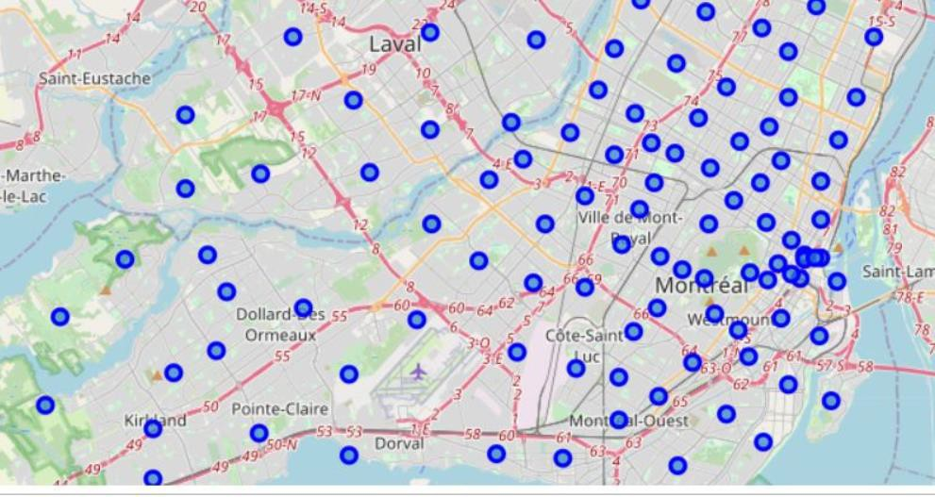
Methodology
In this project, we will search for venues using Foursquare API and then cluster our Montreal neighborhoods based on common venues via clustering algorithm Kmeans.
We used a great visualization library Folium to create a map of Montreal using latitude and longitude values.

Slide 5
We will consider the center area of Monreal, downtown and around area with the higher density of people including tourists. The dataset have been narrowed from 122 neighborhoods to 17.
By utilizing the Foursquare API 497 venues have been found, which have been grouped into 150 unique categories.

Slide 6
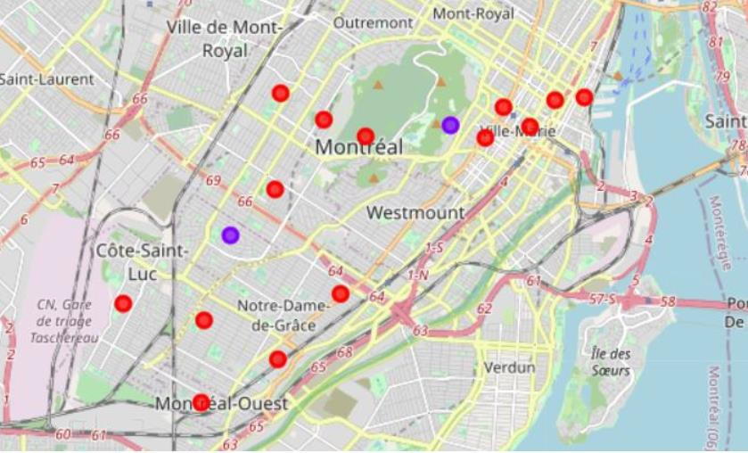
Analysis
To analyze each neighborhood, we grouped rows by neighborhood and by taking the mean of the frequency of occurrence of each category.
The dataset displaying the top 10 venues for each neighborhood has been created.
We have used the clustering algorithm (unsupervised process for the unlabeled dataset) K-means to cluster the Montreal neighborhoods into 3 clusters.

Slide 7
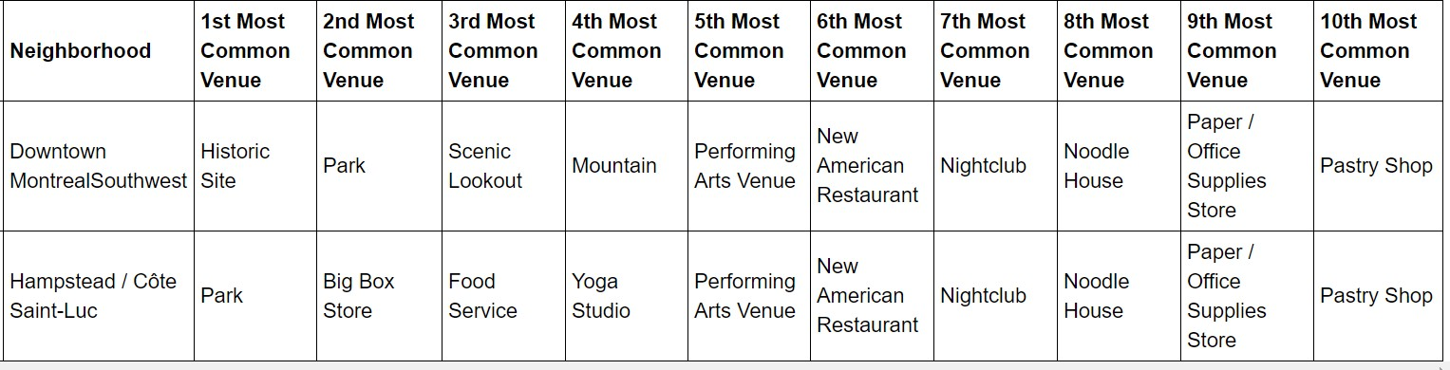
Results and Discussion
- Cluster 1 (red circles) zones are crowded with restaurants as the most common venues
Cluster 2 (purple circles) are not crowded with restaurants at all. Since we have already limited locations by the city center, we will choose between Downtown Montreal Southwest and Hampstead / Côte Saint-Luc (see below).
Downtown Montreal Southwest could be the best one since it includes large green spaces and recreational facilities. That is a popular area and could be the best location to open the new Korean restaurant.

Slide 8
Conclusion
By using Foursquare API we found the most common venues and then clustered our neighborhoods based on common venues.
The optimal location to open a new restaurant will be offered to stakeholders for the final decision. The other specific characteristics and additional factors can be taken into consideration, but it is not a part of this project.

